Slide 1
Analytical computation of sojourn time distributions in large scale conveyer systems
K. Furmans (KA), T. Schmidt (DD), I. Meinhardt (DD), M. Epp (KA), M. Rimmele (KA)
DD: TU Dresden, Germany
KA: Karlsruhe Institute of Technology, Germany
Supported by DFG-grant 273/12-1
273/12-2

Slide 2
Purpose
Why are engineers interested in stochastic models?

Slide 3
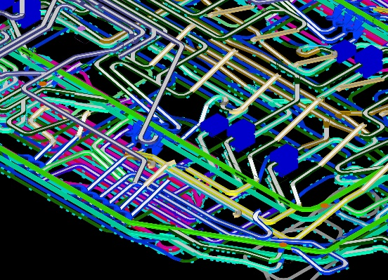
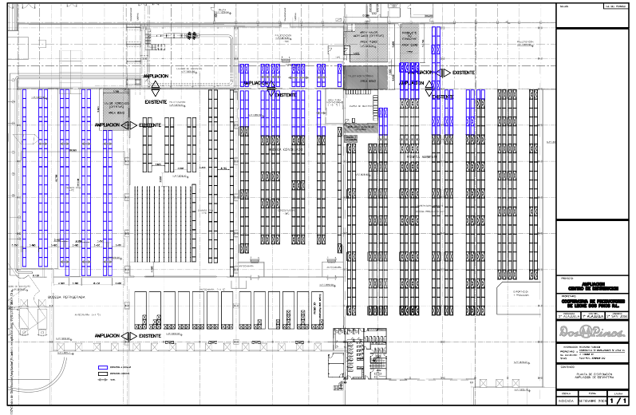
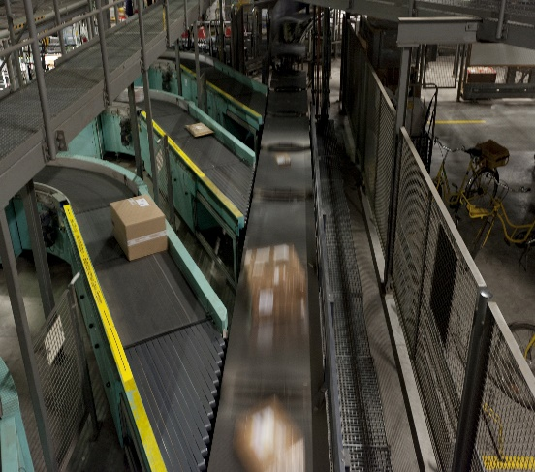
Decomposition
Large Scale Material Handling Systems
Typical applications
  Baggage handling systems
  Large Distribution Centers
  Parcel-handling facilities
Transit times have to be guaranteed with a given probability -> quantiles of total time in system necessary
Warehouse & Distribution Science, at the Georgia Institute of Technology, by John J. BARTHOLDI, III and Steven T. HACKMAN
Source: www.siemens.com/press

Slide 4
Approach
Decomposition
Creating new building blocks if necessray
Software - making it usable

Slide 5
Simple Discrete Time Queueing System:
G|G|1-queue → A Stochastic Finite Element
distribution of the interarrival time
distribution of the service time
i
i
G|G|1-queueing station
distribution of the interdeparture time
customer order
distribution of the waiting time
buffer
i
i
distribution of number of customers in arrival instants
i

Slide 6
Input Data Requirements
conveyor
λ
1
service time description of this material handling device
λ
FE
λ
2
material
handling device
λ
3
i
Material flow processes can be described well by discrete distributions
Multi-modal distributions functions can be used
Date of an as-is analysis are generally available in discrete form

Slide 7
Decompisition – Required Components vs. Existing Models
material flow element | routing strategy / dispatching rule | existing models |  |  |  |  | modified models
 |  | batch building - capacity rule | G|G|1 | G^{x}|G|1 | stochastic divert | stochastic merge
batch decomposition | FIFO | x
collection station | FIFO | x | x
operator station | FIFO |  | x | x
conveyor | no accumulating capability |  |  |  |  |  | x
 | accumulating capability |  |  |  |  |  | x
 | circulating vertical conveyor |  |  |  |  |  | x
crossing element | FIFO |  |  | x | x | x | x
 | time window |  |  |  |  |  | x
 | block handling |  |  |  |  |  | x
 | round robin |  |  |  | x |  | x
 | limited priority |  |  |  |  |  | x
 | absolute priority |  |  |  |  |  | x
continuous divert | stochastic |  |  |  | x
 | deterministic |  |  |  |  |  | x
partially continuous divert | stochastic |  | x |  | x
 | deterministic |  |  |  |  |  | x
Merge | FIFO |  |  |  |  | x | x
 | time window |  |  |  |  |  | x
 | block handling |  |  |  |  |  | x
 | limited priority |  |  |  |  |  | x
 | absolute priority |  |  |  |  |  | x

Slide 8
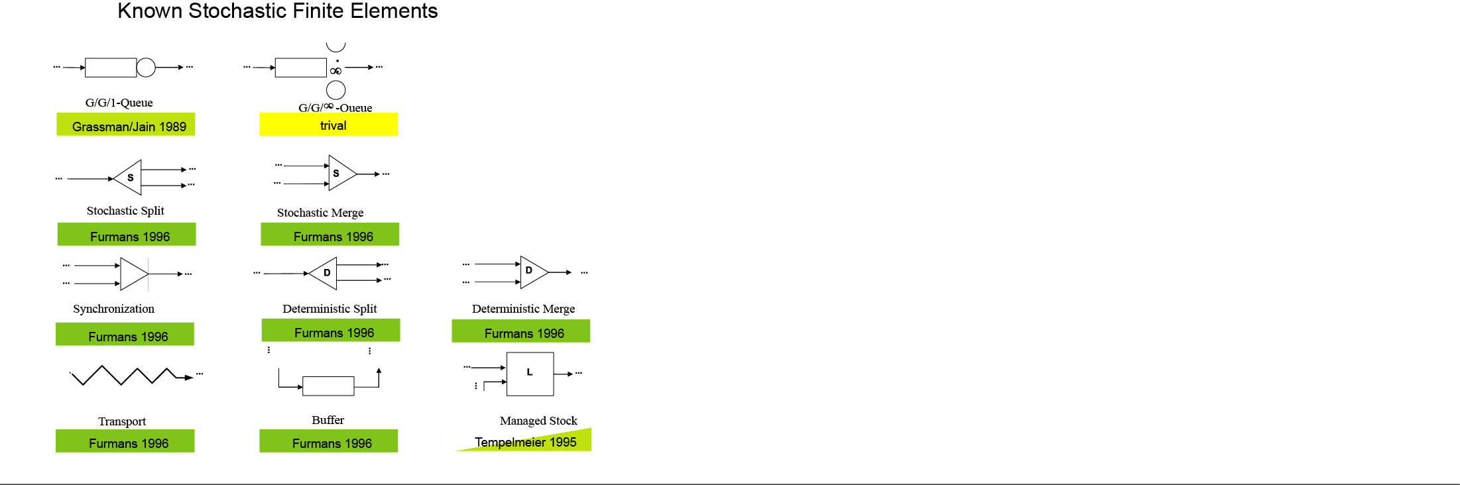
Decomposition - Library of Stochastic Finite Elements (2007)
G/Gm-Queue
under Construction
S
D
Loops
No Proof / no counterexample

Slide 9

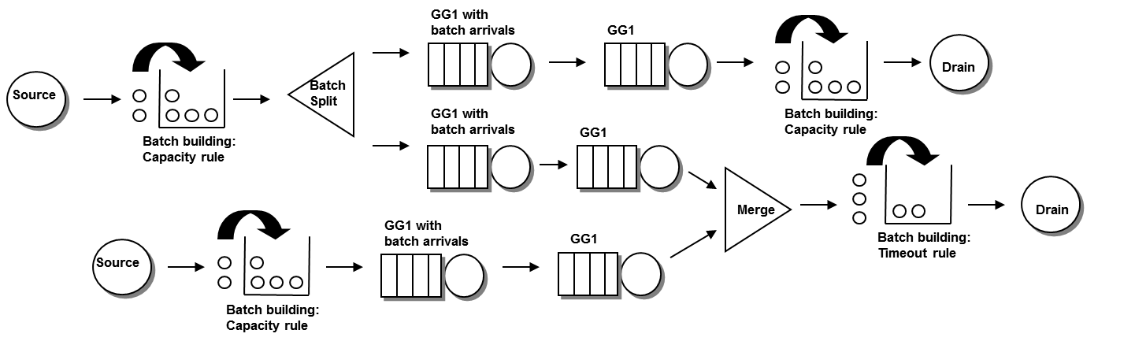
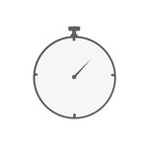






Decomposition - Library of Stochastic Finite Elements (2015)
G/Gm-Queue
Batch building
Stoll 2011
Özden 2012
S
D
Loops
Polling / Round robin
No Proof / no counterexample
Rimmele 2015
Cycle Times
Epp et al. 2015
Closed networks
Epp et al. 2015

Slide 10
Embedded Markov-Chains:
Mathematical Modelling
The good news
  All imaginable problems can be modelled
The bad news
  Computation times might be too long
There is a common pattern

Slide 11


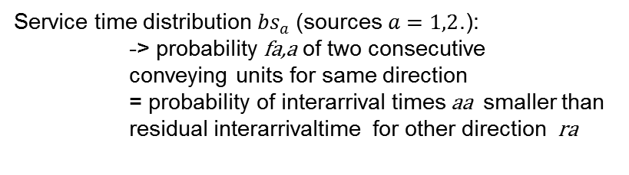
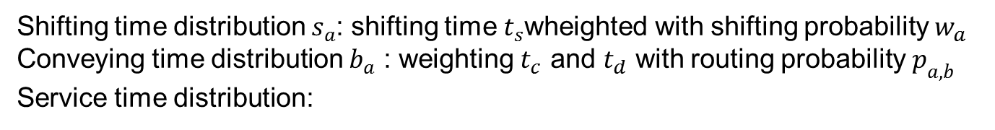
New building blocks – a simple example
$$t_{c}$$
The task
Service time distribution ${bs}_{a}$ (sources $a=1,2$.):
-> probability fa,a of two consecutive
conveying units for same direction
= probability of interarrival times aa smaller than
residual interarrivaltime for other direction ra
$$t_{d}$$
Shifting probabilities: $w_{a}$ with routing probability $p_{a,b}$ from source $a$ to sink $b$:
Shifting time distribution $s_{a}$: shifting time $t_{s}$wheighted with shifting probability $w_{a}$
Conveying time distribution $b_{a}$ : weighting $t_{c}$ and $t_{d}$ with routing probability $p_{a,b}$
Service time distribution:

Slide 12
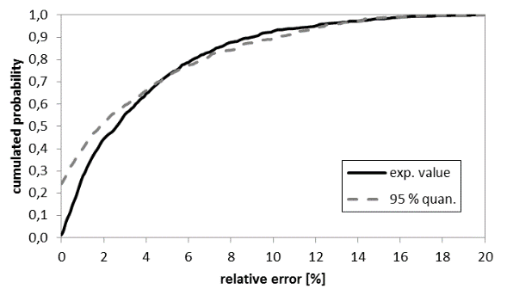
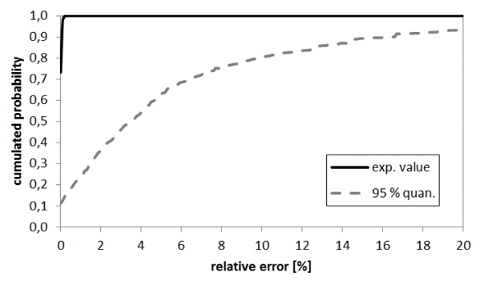
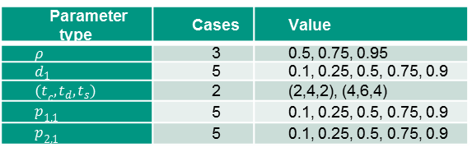
New building blocks – a simple example
Quality of the approximation
Parameter type | Cases | Value
$ρ$ | 3 | 0.5, 0.75, 0.95
$d_{1}$ | 5 | 0.1, 0.25, 0.5, 0.75, 0.9
${(t}_{c},t_{d},t_{s})$ | 2 | (2,4,2), (4,6,4)
$p_{1,1}$ | 5 | 0.1, 0.25, 0.5, 0.75, 0.9
$p_{2,1}$ | 5 | 0.1, 0.25, 0.5, 0.75, 0.9
waiting time
Inter-departure time

Slide 13
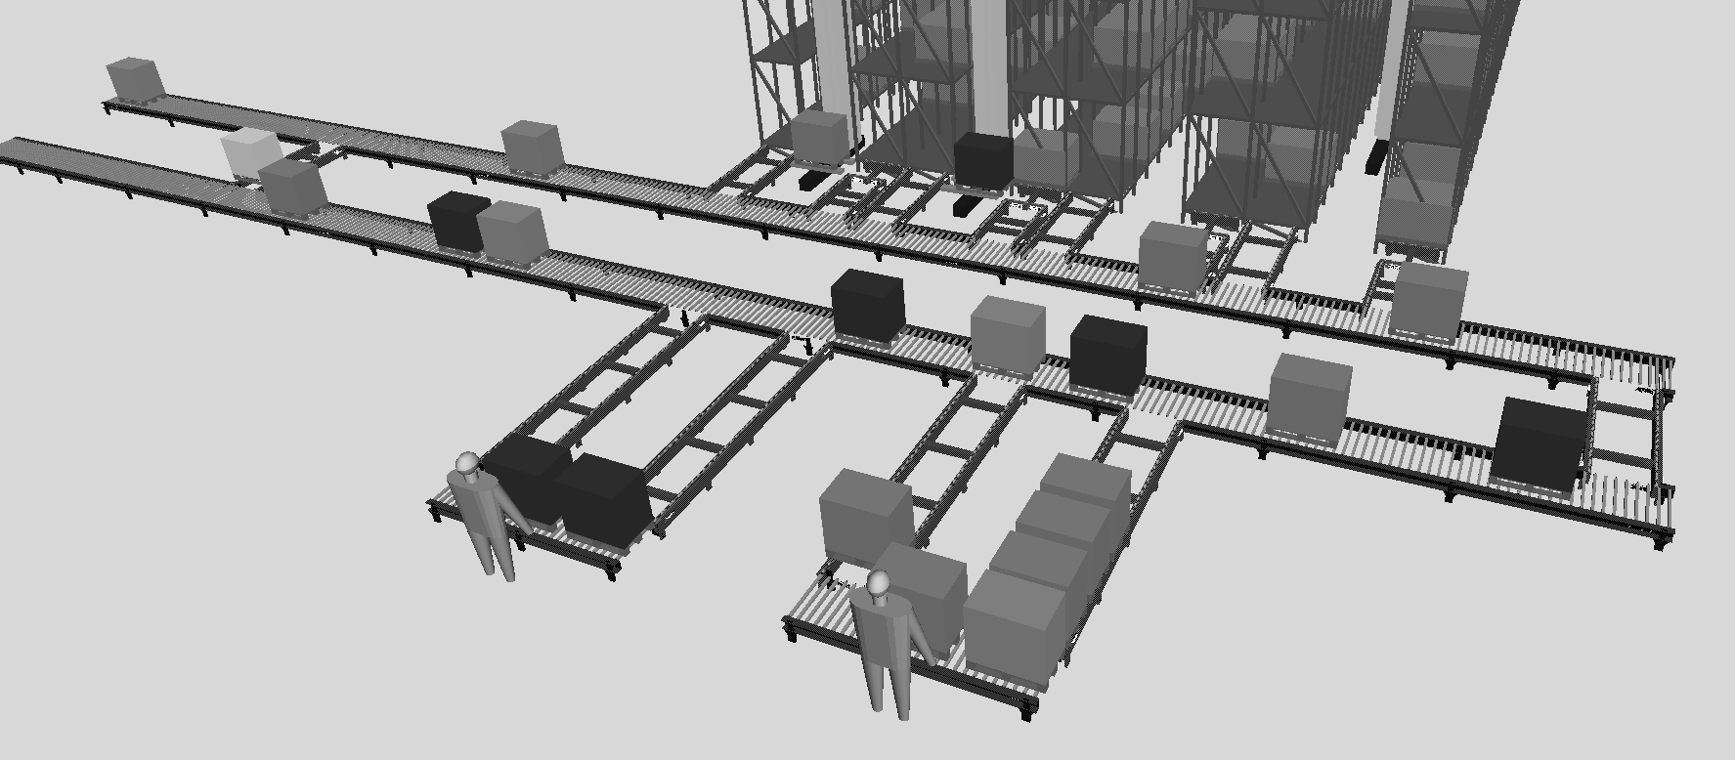
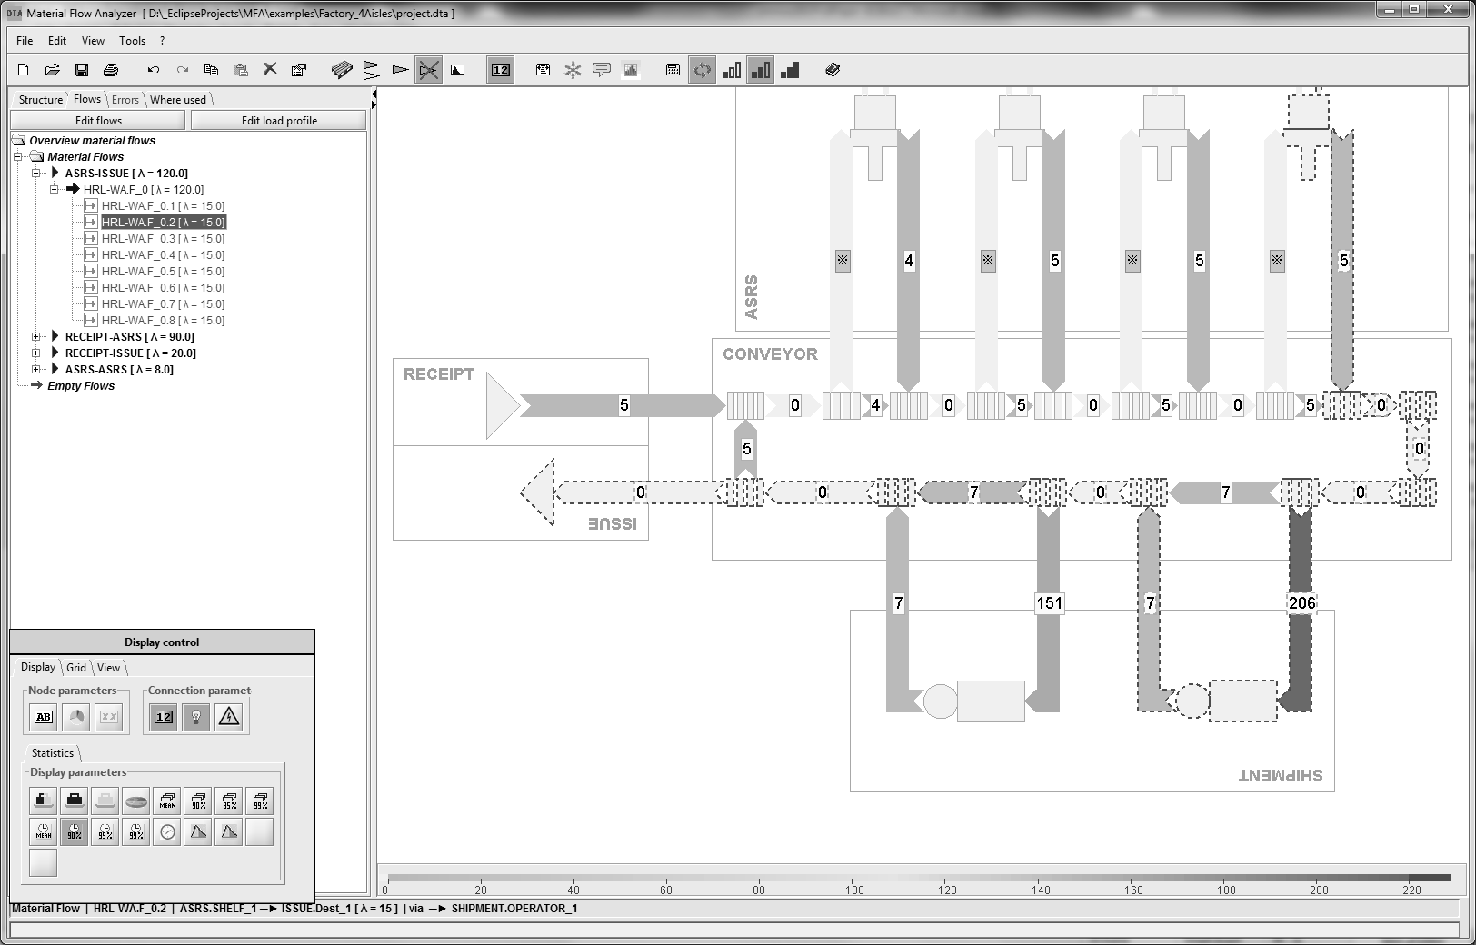
Software – trying to make it usable
System:
Model:

Slide 14
Software - architecture
Editor:
flows
nodes
graphical represen-tation
Computation modules
modelling
results

Slide 15
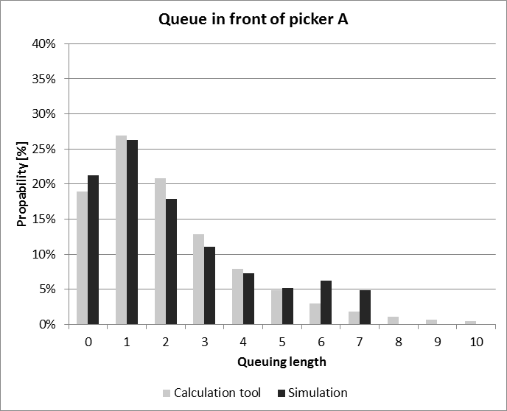
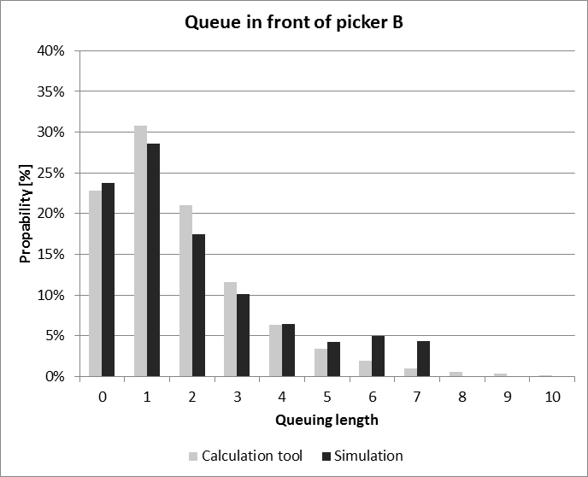
Software – Quality of Results on Workstation Level
Comparison of the queue lengths before the two service stations.

Slide 16
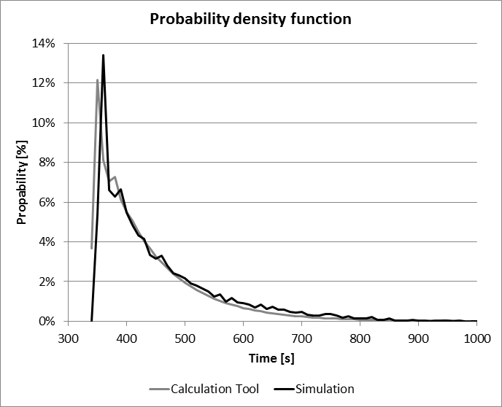
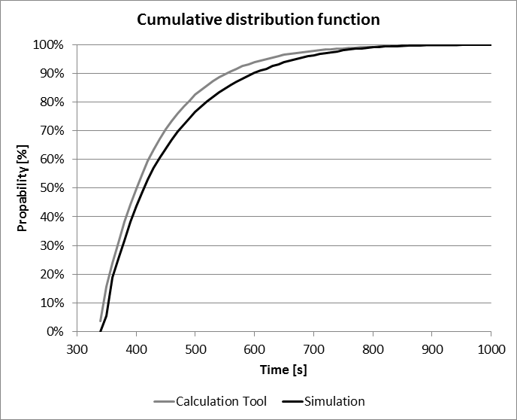
Software – Quality of Results on System Level
Sojourn time for one class of orders:
stock removal from aisle 1 to goods issue

Slide 17
Demonstration

